Slide 1
Convolutional Neural Networks (CNNs)
Generated for: Convolutional Neural Networks (CNNs), Introduction to CNNs, Convolution Operation, Pooling Layers, CNN Architecture Example, Applications of CNNs
Notes:
Welcome to the Convolutional Neural Networks (CNNs) presentation covering multiple topics. Today we'll explore: Convolutional Neural Networks (CNNs), Introduction to CNNs, Convolution Operation, Pooling Layers, CNN Architecture Example, Applications of CNNs.

Slide 2
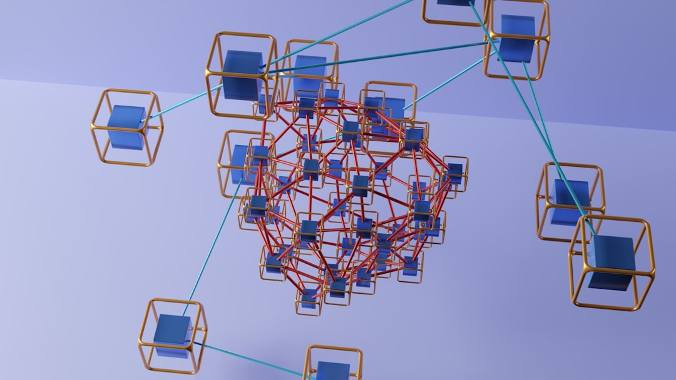
Convolutional Neural Networks (CNNs) - Introduction
CNNs are deep learning models for image processing tasks
Inspired by biological neural networks and visual cortex
Use convolutional and pooling layers for feature extraction
Convolutional layers apply filters to small image regions
Pooling layers downsample data for reduced dimensionality
CNNs are widely used for image classification and object detection
Applications include self-driving cars and facial recognition
CNNs can learn spatial hierarchies of image features
Enable robust image recognition and classification performance
Notes:
When introducing CNNs, emphasize their biological inspiration and unique architecture. Explain how convolutional and pooling layers work together for feature extraction. Provide examples of CNN applications, such as image classification and object detection. Ask students to consider the advantages of using CNNs for image processing tasks. Key takeaways include understanding the basic components of CNNs and their ability to learn spatial hierarchies of image features.

Slide 3
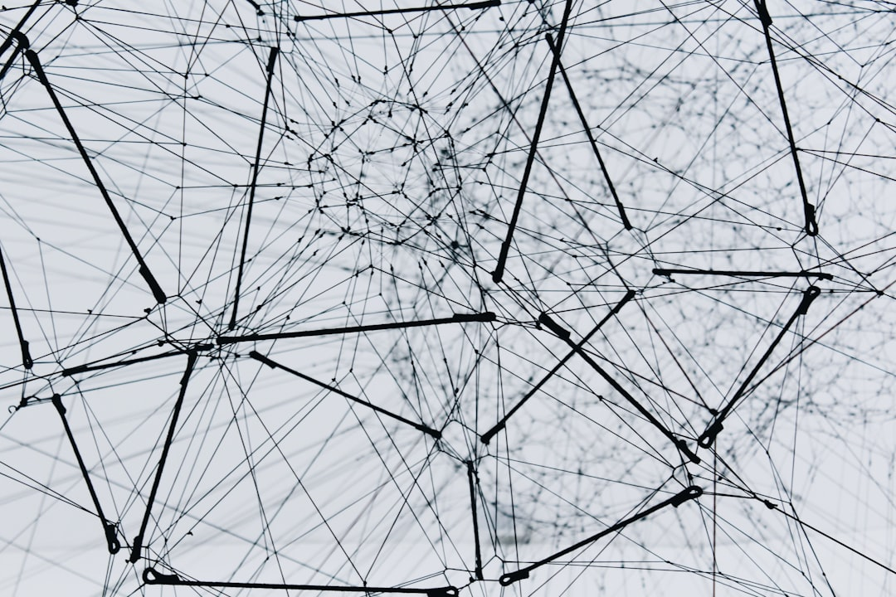
Convolutional Neural Networks (CNNs) - Architecture
CNNs use convolutional and pooling layers
Convolutional layers extract local features
Pooling layers reduce spatial dimensions
Fully connected layers for classification
ReLU activation function is commonly used
Batch normalization improves training speed
Dropout prevents overfitting in networks
Conv2D layer for 2D convolution operations
Max pooling for downsampling data
Notes:
When explaining the architecture of CNNs, emphasize the role of each layer type, such as how convolutional layers use filters to extract features and how pooling layers reduce dimensionality. Provide examples of how these layers are used in real-world applications like image classification. Ask students to consider how the architecture of a CNN would change for different tasks, such as object detection or image segmentation. Key takeaways should include understanding the basic components of a CNN and how they contribute to its overall function.

Slide 4
Convolutional Neural Networks (CNNs) - Architecture
Consist of convolutional and pooling layers
Use convolutional layers for feature extraction
Pooling layers reduce spatial dimensions
Fully connected layers for classification
Activation functions introduce non-linearity
ReLU is a commonly used activation function
Batch normalization improves training speed
Dropout prevents overfitting in networks
Convolutional layers use filters to scan inputs
Notes:
When explaining the architecture of CNNs, emphasize the role of convolutional and pooling layers in feature extraction and dimensionality reduction. Provide examples of how these layers are used in image classification tasks, such as handwritten digit recognition. Ask students to consider how the choice of activation function, like ReLU, affects the network's ability to learn complex patterns. Discuss the importance of batch normalization and dropout in improving the stability and generalizability of the network. Key takeaways include understanding the components of a CNN and their functions, as well as the importance of regularization techniques.

Slide 5
Introduction to CNNs - Introduction
Convolutional Neural Networks (CNNs) are deep learning models
Inspired by structure and function of human brain
Used for image and video processing applications
CNNs consist of convolutional and pooling layers
Activation functions used to introduce non-linearity
Training involves optimizing weights and biases
Backpropagation algorithm is commonly used
CNNs have many applications in computer vision
Examples include object detection and image classification
Notes:
When introducing CNNs, start by explaining the inspiration behind these models, which is the structure and function of the human brain. Provide examples of how CNNs are used in real-world applications such as image and video processing. Emphasize the key components of CNNs, including convolutional and pooling layers, and the role of activation functions. Discuss the training process and the importance of optimizing weights and biases. Use simple examples to illustrate how backpropagation works. Ask students to think about potential applications of CNNs in computer vision, such as object detection and image classification, and encourage them to explore these topics further.

